Slide 1


Luce Labs Control Project
Jacob Kozik
July 20, 2026
Fig. 1. Modified screenshot of a Luce Labs growing rack [1]

Slide 2


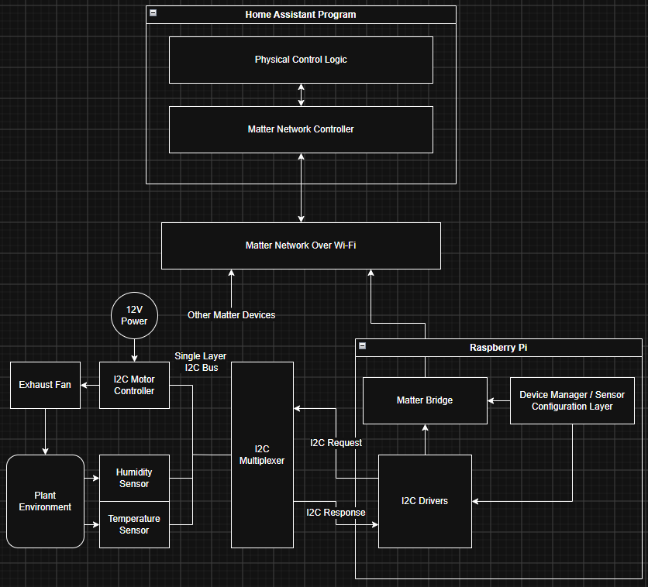
System Architecture Overview
The primary architectural goal is to maximize modularity and longevity while keeping cost and user complexity minimal.
•
Matter Integration: Leverages Home Assistant (HA) as the central controller.
•
Shared I2C Bus: Uses I2C multiplexers so sensors can be uniquely identified and reused across every rack layer.
•
Raspberry Pi: Acts as the Matter Bridge, detecting new sensors and assigning devices within the network. It also coordinates control signals to the I2C actuators.

Slide 3






Hardware & Software Layers
I2C Hardware
Matter SDK
Home Assistant
Sensors plug into specific rack layers. The I2C multiplexer allows the Raspberry Pi to detect and assign unique I2C addresses dynamically.
Configured using C++. The Raspberry Pi application layer (written in Python) interfaces with Linux, configuring each layer as a discrete Matter device.
The Matter Controller subscribes to the devices published by the Pi. Each layer maintains updated sensor data and actuator controls.

Slide 4


Architectural Trade-offs
System Advantages
System Drawbacks
•
Plug-and-Play Setup: Users simply plug sensors into I2C ports and select the device type from a pre-configured list.
•
Wiring Dependency: Reliant on physical I2C cables rather than wireless mesh networks (e.g., native Zigbee).
•
Granular Control: Because each layer is a unique Matter device, it can be individually monitored and controlled in HA.
•
Environmental Risk: I2C connectors require specialized protection from humidity to prevent rust.
•
Cost Effective: Avoids expensive proprietary wireless protocols per sensor.
•
Development Load: The Raspberry Pi software layer introduces significant complexity and development time.

Slide 5
Single Points of Failure
The current architecture contains critical centralized nodes. Failure mapping reveals two primary vulnerabilities:
Raspberry Pi & I2C Bus Failure All signals route through the Pi and over Wi-Fi. If the Raspberry Pi fails or the primary I2C bus drops, the entire hardware rack ceases to function.
Home Assistant Controller Failure If the Home Assistant server loses power or drops off the network, all connected racks lose their control logic and synchronization.
Proposed Mitigation Strategy Run the primary control logic locally on the Raspberry Pi. Home Assistant will only send operational parameters to a prebuilt control function, ensuring racks remain functional offline.

Slide 6
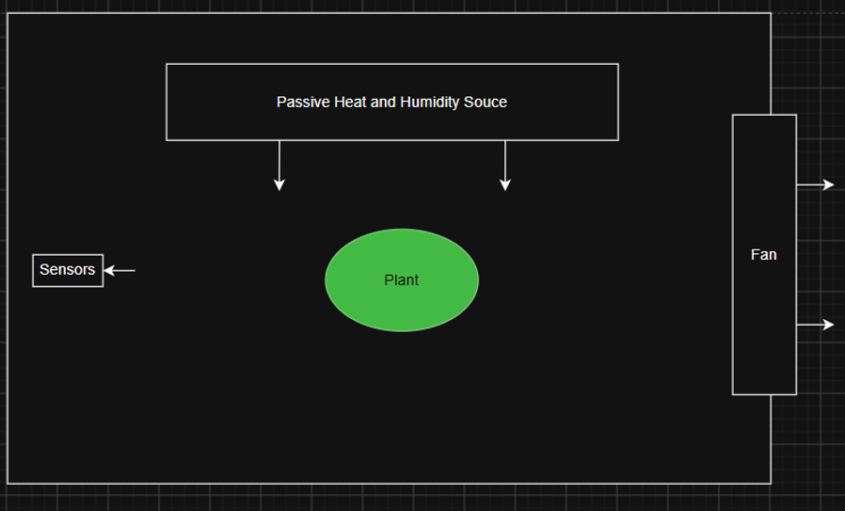
Control System Design
Hysteresis Regulation
The core control algorithm utilizes a threshold-based hysteresis controller. To ensure stability and prevent erratic triggering from sensor fluctuations, a digital lowpass filter is applied to attenuate high-frequency noise.
Actuator Focus: The primary actuator is the exhaust fan. It serves as a homogeneous regulator, actively exhausting both excess heat and accumulated humidity from the plant environment.

Slide 7




Control Logic Execution
2. Signal Filtering
Apply digital low pass filters to the raw data stream to eliminate false spikes.
4. Actuation
Trigger the exhaust fan via PWM from an I2C signal.
1. Data Acquisition
3. Threshold Comparison
Poll I2C sensors sequentially to read real-time temperature and ambient humidity.
Compare the smoothed data against upper/lower control limits defined by Home Assistant.

Slide 8
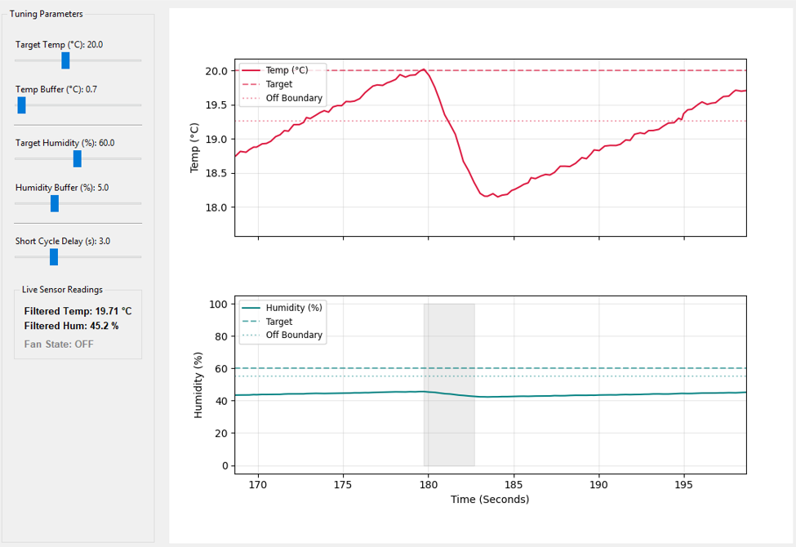
Control Simulation
// Basic Low Pass filter (moving average) if sampling rate is sufficient
temperature = (previous_temperature + current_temperature)/2
relative_humidity = (previous_humidity + current_humidity)/2
// Tuning parameter placeholders
humidity_buffer = 5
temp_buffer = 5
target_temp = 20
target_humidity = 60
short_cycle_delay = 500
// Control logic
current_time = get_time()
state_duration = current_time – last_state_change
if fan_state == on AND (temperature <= target_temp - temp_buffer AND relative_humidity <= target_humidity - humidity_buffer) AND state_duration >= short_cycle_delay:
fan_state = off
last_state_change = current_time
else if fan_state == off AND (temperature > target_temp OR relative_humidity > target_humidity) AND state_duration >= short_cycle_delay:
fan_state = on
last_state_change = current_time

Slide 9


Simulation Findings
Controller Limitations
Proposed Alternative Controller
•
Humidity: The simulation revealed a persistent steady-state error in humidity regulation.
If a bidirectional fan is used, it may be possible to have intake air and exhaust air take different paths through a smart filter such as a tesla valve. One path can cool the air with heat sinks (targeting temperature) and the other can exhaust the air to the room (targeting humidity and temperature).
•
Temperature: Exhibited sustained oscillations between thresholds in the exhaust mechanism.
•
Improvement: Findings indicate that a bidirectional fan controller (intake & exhaust) is necessary for precise control.

Slide 10

Sensor Selection Matrix
Main Sensor PCBs
Sensor Model | Price (Est.) | Temp. Accuracy | Humidity Accuracy | Pressure Accuracy
Adafruit Sensirion SHT45 | $12.50 | ±0.1°C | ±1.0% | n/a
Adafruit BME280 | $14.95 | ±1.0°C | ±3.0% | ±1.0 hPa
Fan Controller and Additional Sensor
Sensor/Fan Controller | Price (Est.) | Temp. Accuracy | Control Interface | Key Features
Adafruit EMC2101 | $5.95 | ±1.0°C | I2C -> PWM with a required 12V power supply | Tachometer and temperature sensors

Slide 11
Actuator Selection Matrix
Evaluation of Fans
Component | Type | Key Feature | Cost (Est.)
Noctua NF-F12 IP67 | Exhaust Fan | Industrial Water & Dust Protection | $29.95
ARCTIC P12 PWM PST | Exhaust Fan | High Static Pressure, Daisy Chain, Cheaper | $10.99

Slide 12





AI Utility in Design Process
1. Conceptual Learning
2. Logic Simulation
3. Configuration
Leveraged for generating initial Python scripts to simulate the hysteresis control loops and plot the temperature and humidity.
Used to draft and format the boilerplate YAML configuration files necessary for Home Assistant entity mapping and integrations.
AI models were utilized to quickly synthesize and comprehend the complex differences between Matter, Thread, and native Home Assistant protocols.

Slide 13
Questions?
Thank you for your time and feedback.

Slide 14
Reference
[1] Luce Labs, "Luce Labs," https://www.lucelabs.ai/, accessed Jul. 23, 2026.

